Slide 1
Lecture No 12

Slide 2
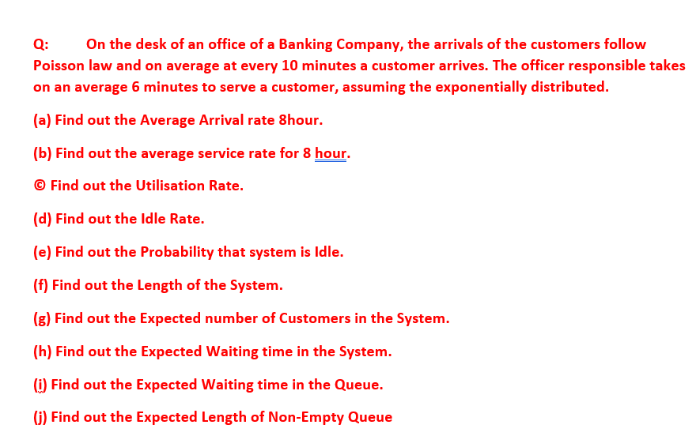



































Slide 3





















Slide 4


































Slide 5


























Slide 6





























Slide 7













































Slide 8


































Slide 9





















































Slide 10




























































Slide 11


















































Slide 12






















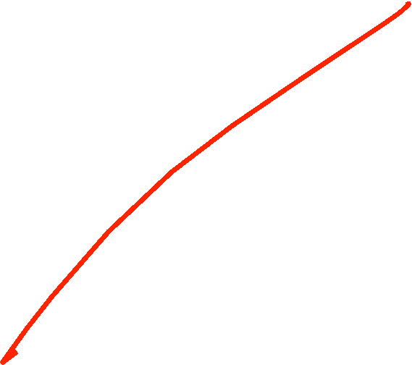

Slide 13
















































Slide 14



































Slide 15





















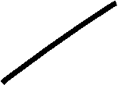











































Slide 16






























Slide 17





























Slide 18






































Slide 19

















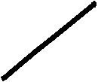

















































Slide 20












































Slide 26


















































Slide 27



























Slide 28











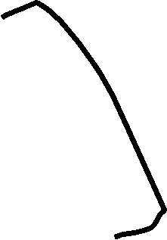










Slide 29











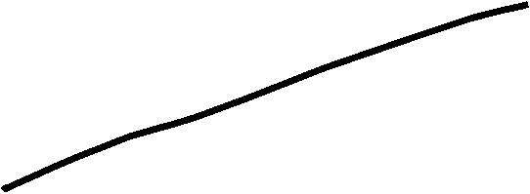



























Slide 30
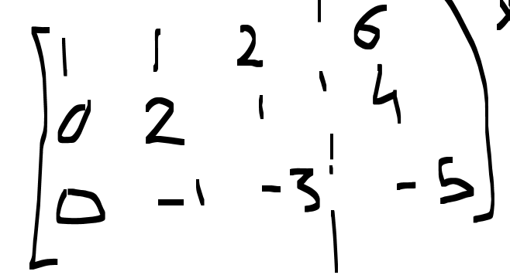





































Slide 31
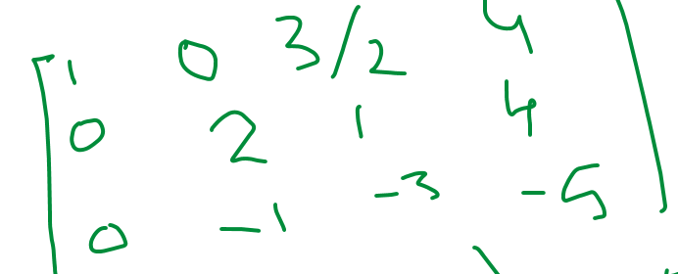











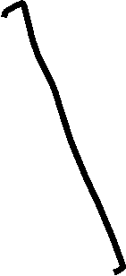


























Slide 32
